Slide 1
Allocation of Essential Resources in Atlanta, GA
A comprehensive look into income inequality
and residential segregation
AKHIL PERIMBETI

Slide 2
Introduction
Atlanta was found to be the city with the highest income disparity between residents, where the highest income earners in the region make nearly nine times more than the lowest income earners
Atlanta, Georgia is highly segregated in terms of race and ethnicity (U.S Census Bureau 2018).
The area’s high segregation and concentrated poverty are factors that add to this disparity, where the spatial proximity among adjacent neighbourhoods has a large impact on overall levels of racial segregation. The clustering of disadvantaged neighborhoods make the residents of these neighborhoods face more failure in all socioeconomic fronts.
In this study I explored the disparity between neighborhoods in terms of race and income-level affecting the presence of venues essential for neighborhood growth and well-being, such healthcare facilities, educational resources and nutrition resources.
The goal is for authorities in Atlanta to clearly identify neighborhoods at risk, as well as the disparity in the allocation of health-care , nutrition and education resource venues to provide these resources for communities in need accordingly.

Slide 3
Data
Data pulled from open-source 2018 Census Database from https://opendata.atlantaregional.com
The communities were defined either as one or a set of smaller set of neighborhoods in Neighborhood Statistical Areas (NSAs) as defined by the Atlanta Regional Commision and the Atlanta Housing Authority.
One was the neighborhoods in Atlanta, their corresponding population demographics and their Neighborhood Statistical Area. I pulled two other sources of information concerning income data relating to each neighborhood in Atlanta as well as poverty by Neighborhood Statistical Area. All this data was collected very recently in 2018.
Essential resources for each community were searched using the Foursquare API based on the latitude and longitude of each community gathered utilizing the geopy python package.
The geojson file of Atlanta statistical areas used to indicate boundaries on the maps was taken from the Atlanta Regional Commision.

Slide 4
Data (contd.)
NSA’s (Neighborhood Statistical Areas):
Defined by the Atlanta Regional Commision
These areas that are built from census blocks
Have a minimum population of 2,000
Consist of either a single large neighborhood or a set of contiguous smaller neighborhoods.
Used Median Household Income, Population Demographic percentages, Median House Sale Price, NSA’s, Community Names, Percent of population living below the poverty line, and Latitude & Longitude values for GeoPy.

Slide 5
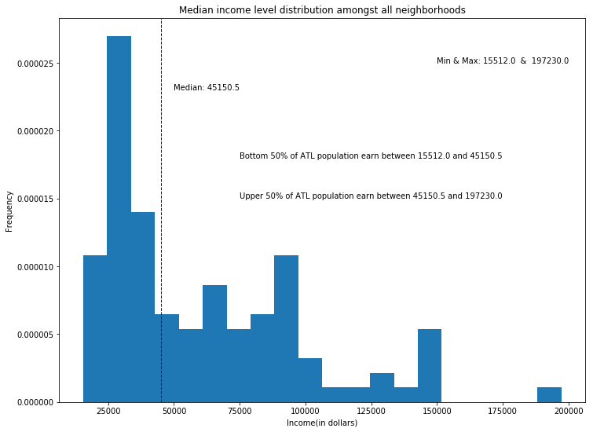
Results & Analysis - (Visualization)
Figure 1: Histogram distribution of Median Household Income

Slide 6
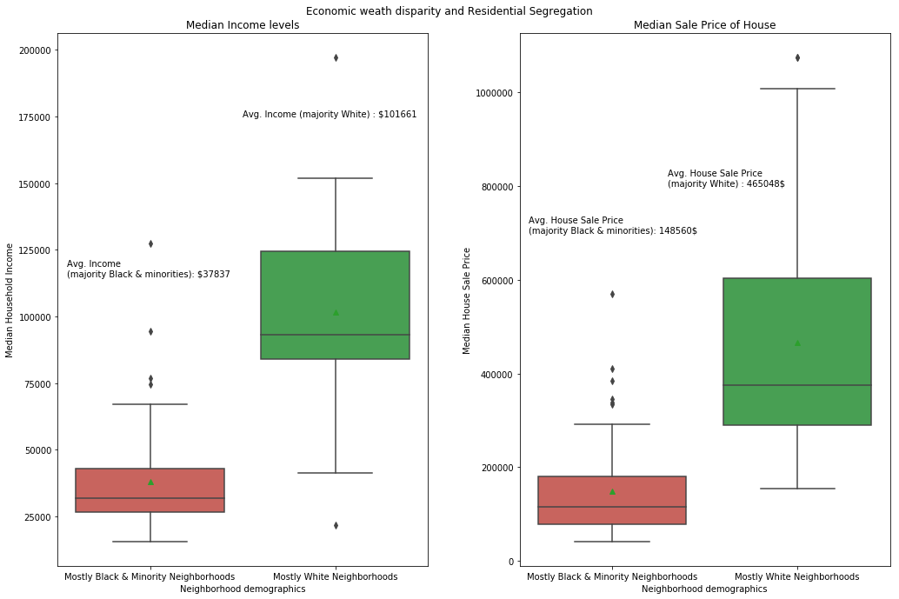
Results & Analysis - (Visualization)
Figure 2: Boxplot distribution of Income and House price levels, by racial majority

Slide 7
Results & Analysis - (Foursquare Venue Types)
Most common venue types in the 10 neighborhoods with highest White population demographics :
['American Restaurant', 'Art Gallery', 'BBQ Joint', 'Big Box Store', 'Breakfast Spot', 'Burger Joint', 'Café', 'Caribbean Restaurant', 'Coffee Shop', 'Cosmetics Shop', 'Department Store', 'Fast Food Restaurant', 'French Restaurant', 'Garden', 'Gas Station', 'Golf Course', 'Grocery Store', 'Hotel', 'Italian Restaurant', 'Mexican Restaurant', 'Outdoors & Recreation', 'Park', 'Pizza Place', 'Pool', 'Seafood Restaurant', 'Shopping Mall', 'Ski Trail', 'Southern / Soul Food Restaurant', 'Steakhouse', 'Theater', 'Wings Joint']
Most common venue types in the 10 neighborhoods with highest Black & minority population demographics :
['American Restaurant', 'Art Gallery', 'Bank', 'Breakfast Spot', 'Chinese Restaurant', 'Convenience Store', 'Cosmetics Shop', 'Discount Store', 'Fast Food Restaurant', 'Food', 'Fried Chicken Joint', 'Gas Station', 'Grocery Store', 'Intersection', 'Liquor Store', 'Mexican Restaurant', 'Mobile Phone Shop', 'Music Store', 'Park', 'Pharmacy', 'Pizza Place', 'Rental Car Location', 'Sandwich Place', 'Seafood Restaurant', 'Southern / Soul Food Restaurant', 'Spa', 'Storage Facility', 'Wings Joint']
> Based on this information the disparity in the heavy disparity proportion of white and black people in both these neighborhood types. The types of venues in higher income neighborhoods include an abundance of venues such as Cosmetic shops, Gyms, Golf Courses, Cafes and Art Galleries, while the types of neighborhoods in lower income neighborhoods include an abundance of venues such as Discount Stores, Liquor Stores, and Convenience stores. Although there are a few common types of venues between the neighborhoods, I find that the venues that are not common speak huge volumes to the type of venue distribution.

Slide 8
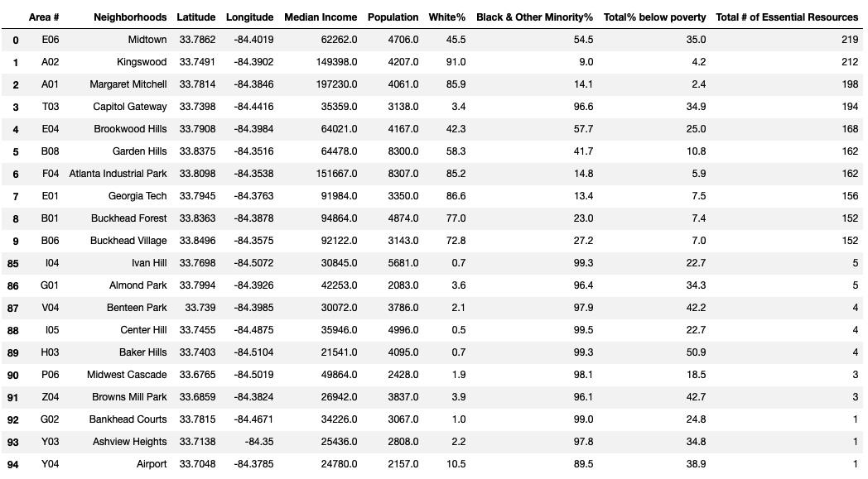
Results & Analysis- (Foursquare essential venues)
Figure 3: Top 10 and bottom 10 communities in Atlanta sorted in terms of total number of resources

Slide 9
Results & Analysis- (Foursquare essential venues)
Average number of education, health and nutritional resources for the top 10 communities: 177.5
Average number of the same essential resources for the bottom 10 communities: 3.1
________________________________________________________________________________
The total number of essential resources for the top 25% of communities is 3309
The total number of essential resources for all communities is 5136
__________________________________________________________________________
> The number of essential-venue resources range from 1-3 (Bankhead Courts & Browns Mill Park) to 212-219 (Kingswood & Midtown). That is an extreme difference present in the allocation and spread of essential resources per neighborhood. When the top 10 and the bottom 10 communities are compared, the average number of resources are 177.5 and 3.1, respectively. The mean for total essential resource was higher than the median, indicating a positive skewness. The distribution of essential resource venues including healthcare facilities, educational resource facilities and nutritional resources shows the most disparity. The top 10 communities in terms of total number of essential resources accounted for almost 40% of the total number of essential resource facilities. The top 25% of the communities had 3309 resources, which is more than half the number of total educational, healthcare and nutrition resources for all the neighborhoods in Atlanta that were gathered from Foursquare.

Slide 10
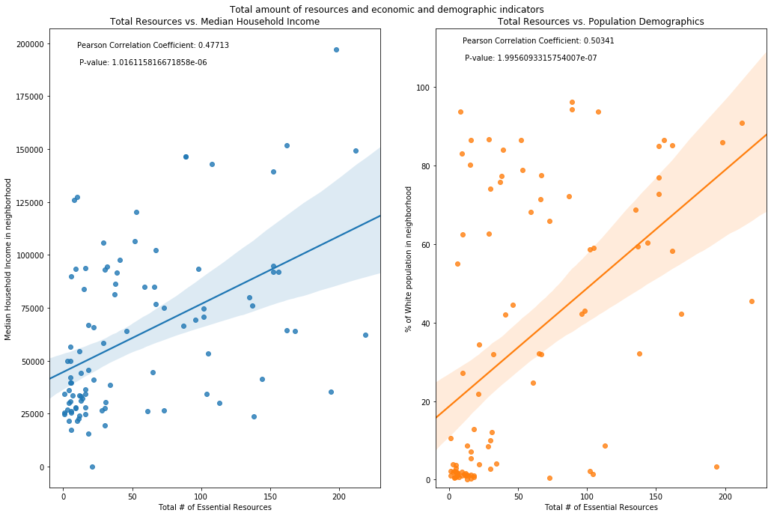
Results & Analysis- (Foursquare essential venues)
Figure 4: Scatterplot of Total Resources against Median Income and Population Demographics

Slide 11
Figure 4. Analysis (contd.)
There are two scatter plots displaying the total number of essential resources against median household income as well as the total number of essential resources against total white population demographic percentage. Regression lines were plotted on both the scatter plots to demonstrate the positive correlation and relationship between number of resources against income levels and population demographics.
The Pearson coefficient was 0.47713 for essential resources against income, which shows a moderate, but not strong, correlation between the two variables. In accordance with the p-value returned, it is also statistically significant at an α = 0.001 level.
The Pearson coefficient was 0.50341 for essential resources against population demographics, which also shows a moderate, but imperceptibly higher, correlation between those two variables. In accordance with the p-value returned, it is also statistically significant at an α = 0.001 level

Slide 12
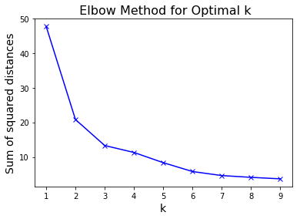
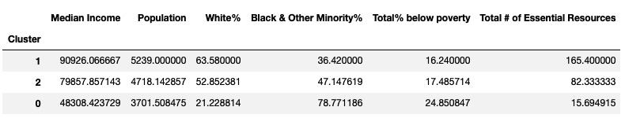
Results & Analysis- (K-Means Clustering)
> Normalizing data using StandardScalar and performing ‘elbow’ method, we determine
Optimal K = 3
> After clustering the data and grouping by those clusters, we get:

Slide 13
K- Means Clustering Analysis (contd.)
Using the 'elbow' method the communities were clustered into 3 different and straightforward groups.
Cluster 1 had communities with the most number of essential resources. We can see for all the clusters that population does not seem to have an effect on the number of resources, but demographics and income seem to. Cluster 1 communities have the highest average household income levels as well as the highest average white population demographic percentage.
Cluster 2 can be characterized as having a significant number of essential resources, but much less than that of Cluster 1. Cluster 2 communities have an even spread in terms of population demographics and have the middle value for income levels amongst the rest of the communities.
With Cluster 0, the average number of resources is significantly lower than that of Clusters 1 and 2. The income level for these groups of communities is the lowest across the board. The population demographics are heavily skewed, with the highest average black and other minority demographic percentages. When ANOVA was performed, the result was significant at α = 0.01, indicating that median income, as well as white population percentage were indeed different across the clusters.

Slide 14
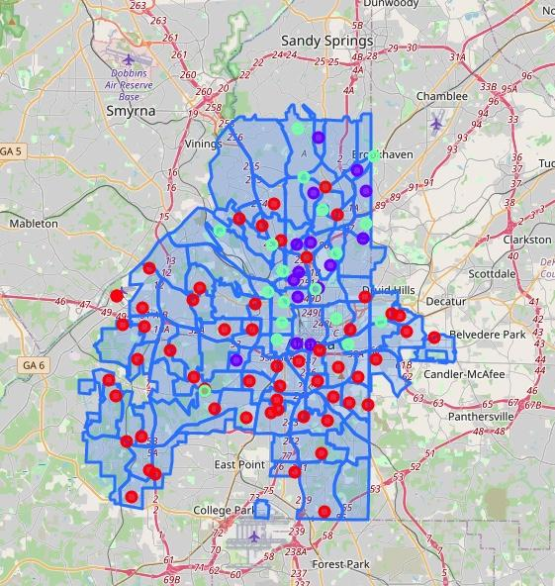
Results & Analysis - (Cluster Map Visualization)
Cluster 0: Red marker Cluster 1: Purple marker Cluster 2: Teal marker
Figure 5: Cluster Map of Neighborhoods in Atlanta, Georgia

Slide 15
Discussion
In this study, the severe gap in median household income was shown to be significantly associated with availability of essential resources for neighborhood growth, such as healthcare and educational facilities as well as healthy nutrition resources.
Residents in neighborhoods such as Margaret Mitchell had a median income level of nearly 198,000 dollars while residents in Greenbriar had a median income level of nearly 15,600 dollars. Such a wide gap in income was shown to have associations with the population demographics of the neighborhoods as well, with Margaret Mitchell having an 86% white population and Greenbriar having a 99% black and other minority population.
Median Household Income is a much more accurate summary measure of income. Median household income is a more robust and accurate measure for summarizing income at the geographic level as compared to average household income since it is not affected by a small number of extremely high or low income outlier households.
Among the categories used in the study, there was an extreme disparity in the total amount of essential resources, ranging from 0 to 219. This should be a severe concern for city officials as well as the residents.
The cluster map we produced shows many communities belong to Cluster 0 and are mostly in the outskirts around the more wealthier neighborhoods and towards the south. This shows a serious segregation based on the location of communities.
Efforts should be concentrated on bringing education, healthcare and nutrition resources to the communities in Cluster 0 that have the lowest median household income and the highest amount of black and other minority populations.

Slide 16
Discussion - (Drawbacks)
I chose communities officially recognized by the regional commision of Atlanta. However, the boundaries of community areas themselves also present a challenge. Except for a few communities that were annexed afterwards, these Neighborhood Statistical areas were charted in 1962 by researchers using available data back then.
Using Foursquare presented a few challenges. There can also be redundancy in counting the venues of each category in this study.
Since I chose to explore venues a certain distance away from a single GPS coordinate representing a community, the venues might be underrepresented or overrepresented, and the area surrounding the GPS coordinate may not be representative of the community area.
In addition, the arbitrary 1250-meter radius should be revised to use an appropriate unit of analysis, which reflects the current situations and how people use the resources around them. Composition of communities should also be taken into consideration. Some extreme cases returned very few resources, maybe due to the fact that a large percentage of these community areas are lowly populated and have amounts of land that are parts of marshes, lakes, landfills, etc.
However, I felt that these discrepancies were not enough to throw the whole picture of my study.

Slide 17
Conclusion
There was such a wide disparity in the median income and population demographics in the communities that residents in Margaret Mitchell nearly made 180,000 more dollars than the residents in Greenbriar. These disparities in income and demographics seemed to stem from and have an effect on the gap in the allocation of the total number of essential resources.
The clusters were straightforward:
Cluster 1 had communities with the most number of essential resources. We can see for all the clusters that population does not seem to have an effect on the number of resources, but demographics and income seem to. Cluster 1 communities have the highest average household income levels as well as the highest average white population demographic percentage.
Cluster 2 can be characterized as having a significant number of essential resources, but much less than that of Cluster 1. Cluster 2 communities have an even spread in terms of population demographics and have the middle value for income levels amongst the rest of the communities.
With Cluster 0, the average number of resources is significantly lower than that of Clusters 1 and 2. These Cluster 0 communities that had a substantially low number of essential resources, must be addressed, so that stakeholders and city officials can improve the infrastructure of those communities to bring in those essential resources.
This study can be used to improve and effectively battle against the systemic residential segregation that prevails in this city. By taking small steps the immense income disparity in the city of Atlanta, Georgia can be combated.

